Slide 1


Representing Immigrant Workers Facing Sex Discrimination:
Current Best Practices and Strategies
Legal Network for 18 September 2025
Gender Equity Webinar 3:00-4:30 pm ET

Slide 2

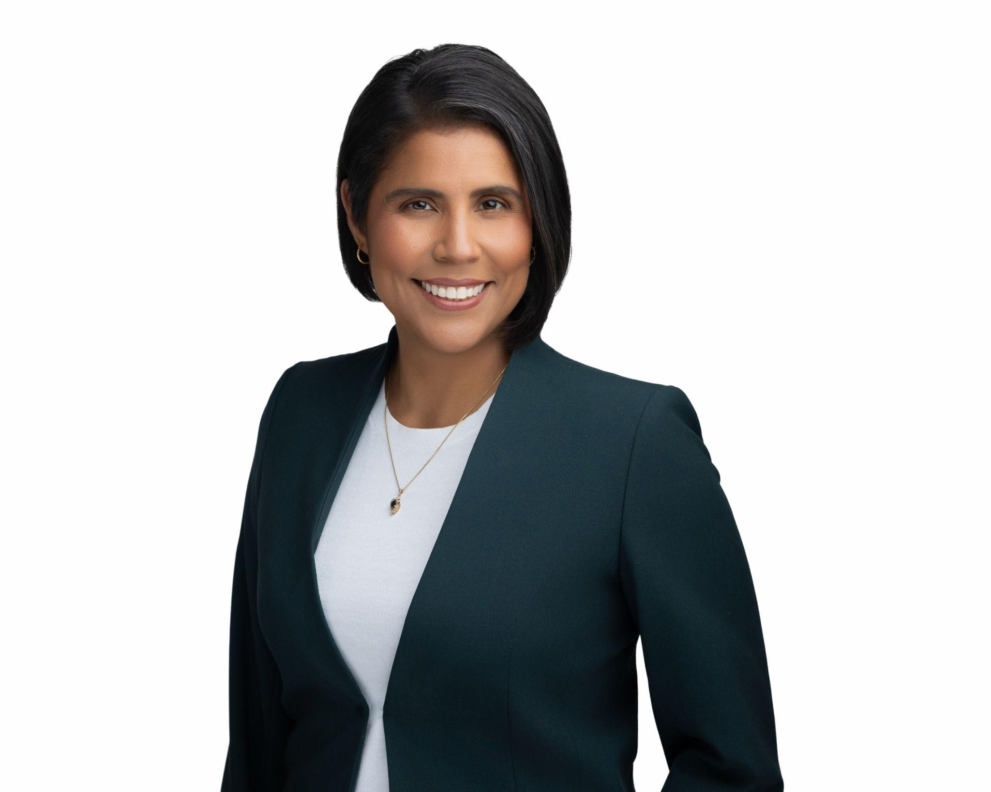
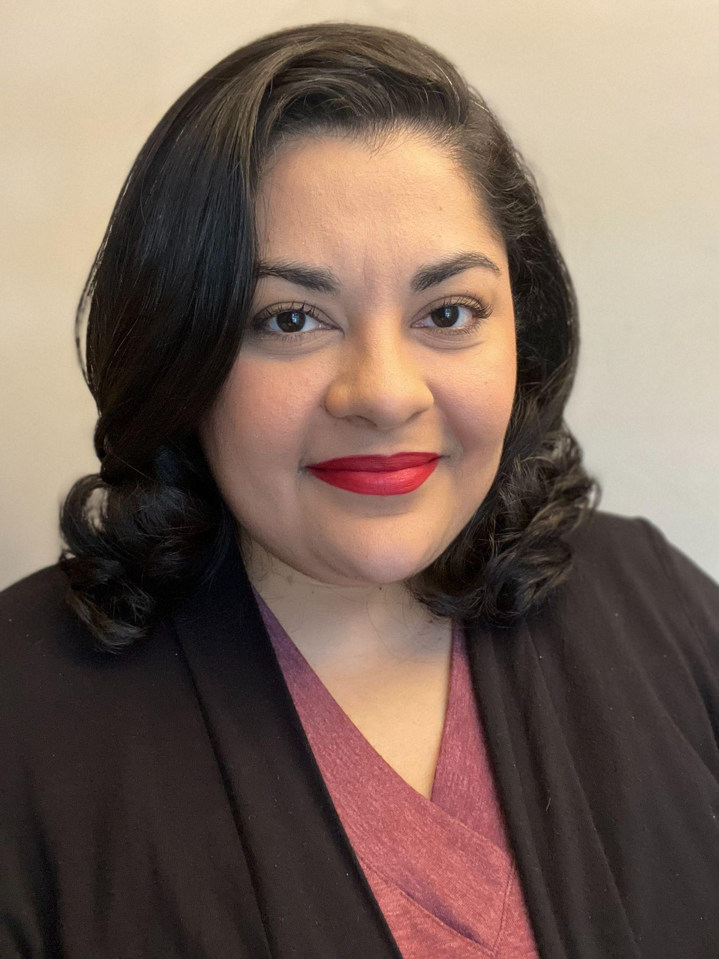



Today’s Presenters
Marisa Díaz (she/her)
Director, Immigrant Worker Justice Program
National Employment Law Project
Diana Marin (she/her)
Senior Counsel
Blanchard Walker PLLC
Adilene Nuñez Huang (she/her)
Director of Client Experience
Tahirih Justice Center

Slide 3
Marisa Díaz (she/her) brings over ten years of experience in advocating for immigrant workers' rights to her position as the Director of the National Employment Law Project’s Immigrant Worker Justice Program (IWJ). Through the IWJ program, Marisa works alongside worker centers and other partners to expand and defend immigrant workers’ rights and to build power in the workplace so all workers, regardless of their immigration status, can thrive in good jobs.
Prior to joining NELP, Marisa was a Senior Staff Attorney in Legal Aid at Work’s National Origin & Immigrants’ Rights Program, where she represented immigrant and other workers in discrimination and retaliation cases and engaged in policy advocacy and community education. Marisa began her legal career as a law clerk to the Honorable Michael Daly Hawkins of the United States Court of Appeals for the Ninth Circuit and then as a legal fellow at Equal Rights Advocates.
Speaker bio 1

Slide 4
Adilene Nuñez Huang (she/her) is currently the Director of Client Experience at the Tahirih Justice Center, where she sets the vision for survivor screenings, program evaluation, and case data management. Adilene led the Afghan Asylum Project, where Tahirih and a pro bono network of over 400 pro bono attorneys provided services to over 200 Afghan survivors who were evacuated out of Afghanistan in August 2021. She most recently served as the Co-Director of Client Advocacy, Legal Services, where she oversaw the legal department and the interdisciplinary client service delivery model.
Adilene is an active member of the AILA DC chapter and has served on a variety of local and national committees. She has written on bond issues, cancellation of removal for non-lawful permanent residents and has spoken at the national AILA conference and local chapter conference. Adilene regularly hosts trainings for the Tahirih Pro Bono network to help pro bono attorneys develop practical, trauma-informed, and client-centered best practices for working with immigrant survivors of violence. Prior to joining Tahirih, Adilene advocated for immigrants at a boutique immigration law firm in Washington, DC.
Speaker bio 1

Slide 5
Speaker bio 1
Diana Marin (she/her) is is a Senior Counsel at Blanchard Walker PLLC. Her legal career has been dedicated to vindicating the rights of vulnerable workers at the intersection of immigration and employment law. She has litigated sexual harassment cases on behalf of immigrant women and women in male-dominated industries. Diana’s movement lawyering approach to legal advocacy was developed in New York City, where she worked alongside grassroots community organizers to fulfill their policy and advocacy goals. Diana has represented diverse groups of workers across many industries, including farmworkers, food workers, day laborers, and domestic workers. Diana currently focuses on impact litigation and complex employment matters on behalf of Michigan workers.

Slide 6
Today’s Agenda
Part I
Current policies and practices impacting
immigrant workers
Part II
Best practices for working with immigrant workers
Part III
Case studies on immigration-related workplace retaliation
Part IV
Q&A and Announcements

Slide 7
Part I
Current policies and practices impacting
immigrant workers

Slide 8
Agenda
Broader immigration context, outside and inside the workplace.
Broader labor/employment context.
Some takeaways for employment lawyers.

Slide 9
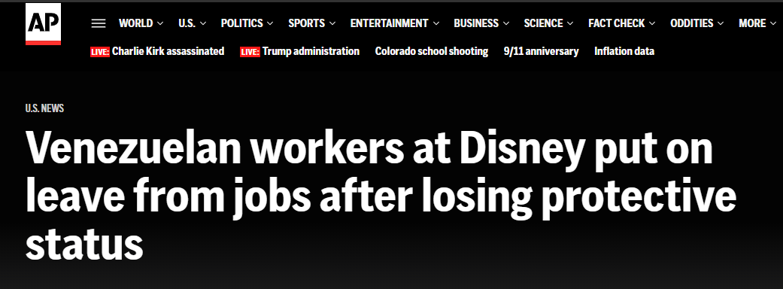
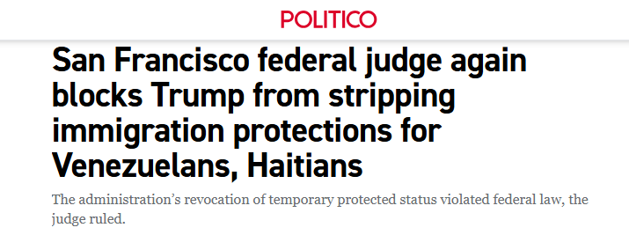
Immigration Context: Mass De-Documentation
Taking away status and work authorization from millions of individuals.

Slide 10
Immigration Context: Block Entry & Pathway to Status
Blocking entry into the U.S. for people from certain countries/statuses.
Making it harder and riskier to apply for any type of status & work authorization.
T Visa
U Visa

Slide 11
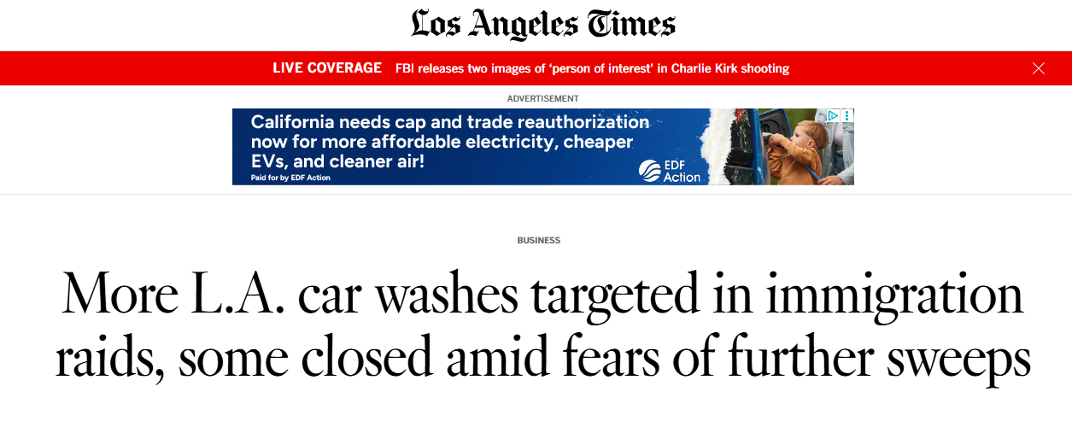
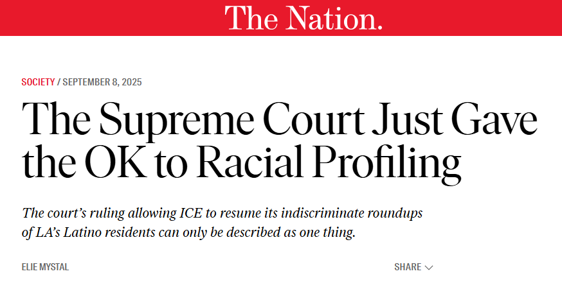
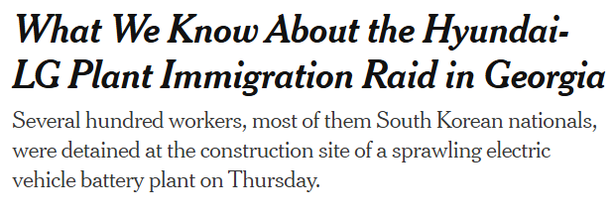
Immigration Context: Mass Deportation & Detention
Increasingly aggressive and militarized enforcement.
No “enforcement priorities” & daily arrest quota.
Expanding detention.
H.R.1 → $170 billion more to increase immigration enforcement.
Exploitative employers emboldened to use immigration status as a tool for retaliation.

Slide 12
Labor & Employment Context: Laws & Regulations
Bedrock federal statutes still in place. Regulations changing.
Opportunities for states (where possible) to strengthen workplace protections for all workers.
Federal courts vs. state courts.

Slide 13
Labor & Employment Context: Agencies.
All:
Information sharing?
Staffing levels.
EEOC:
Emphasis on discrimination against U.S. citizens.
Changing practices related to certain types of discrimination claims.
Still considering requests for U/T visa certification.
Potential changes after quorum reinstated:
Harassment guidance
PWFA rules
Information sharing?

Slide 14
What does this mean?
More important than ever to:
Represent immigrant workers who want to file claims;
Provide effective client counseling and preparation in light of risks;
Build relationships with immigration practitioners, worker centers, etc.;
Consider filing charges at state labor/employment agencies, where available and you have trust in their policies and practices related to immigrant workers.

Slide 15
Part I
Current policies and practices impacting
immigrant workers
Part II
Best practices for working with immigrant workers

Slide 16
Consider barriers to accessing safety and justice
•Language Access
•Distrust of police from home country
•Lack of information regarding legal rights and legal system often through misinformation or intimidation by person in power
•Limited or no access to public benefits

Slide 17
Barriers, continued
•Employment-related barriers
•Work authorization
•Power dynamics
•Lack of understanding of reporting systems
•Lack of other sources of income
•Lack of culturally responsive supportive services
•Cultural Isolation
•Family in US vs. home country
•Personal / family dynamics

Slide 18
Barriers, continued
•Trauma-related
•Feelings of shame
•Lack of coping and processing tools
•Unaddressed past trauma
•The different ways trauma can manifest in a person, for instance:
•Cognitive
•Health-related
•Behavioral
•How much time do you get to spend with them?

Slide 19
Barriers, continued
•What is your role?
•How much time do you get to spend with the survivor?
•How involved can/will you be after the first meeting?

Slide 20
Strategies for working with survivors
1.Work to build trust
•Ensure language access is available, if needed
•Transparency is important - name your role, purpose of your conversation, lay out the process, explain how you can realistically support
•Physical and emotional safety is key – grounding techniques
•Empower the survivor – with information and in autonomy in decision-making
•Remember: this can take time

Slide 21
Strategies for working with survivors
Grounding techniques
•Deep breathing using a method called Box Breathing Technique
https://www.calm.com/blog/box-breathing
•Engaging the five senses using the 5-4-3-2-1 Technique
https://www.calm.com/blog/5-4-3-2-1-a-simple-exercise-to-calm-the-mind?utm_medi-um=organic&utm_source=blog&utm_campaign=breathing-for-stress
•Relaxing the body using Progressive Muscle Relaxation
https://www.healthline.com/health/progressive-muscle-relaxation

Slide 22
Strategies for working with survivors
2.Listen to the survivor and take their lead
•Give information and also listen to the survivor
•Take into account the place the survivor is in mentally (are they prepared to receive information?), emotionally (do they need to prioritize their emotional well-being?), and physically (are they physically okay, are they in a comfortable space, do they have what they need to receive information?)
•Take breaks

Slide 23
Strategies for working with survivors
3.Motivational Interviewing may help
•Is a collaborative communication approach that can be helpful when working with immigrant survivors because it emphasizes empathy and encourages active listening
•May be used to encourage the survivor to engage in “Change Talk” to cultivate a desire, ability, reason, need or commitment to make a positive change in their behavior
Miller, W. R., & Rollnick, S. (2013). Motivational interviewing: Helping people change (3rd edition).

Slide 24
Strategies for working with survivors
3.Motivational Interviewing, cont.: OARS
O – use open ended questions
A – affirmations
R – employ reflective listening
S - summarize
Motivational Interviewing Network of Trainers. https://motivationalinterviewing.org/under-standing-motivational-interviewing

Slide 25
Strategies for working with survivors
4.Be prepared to engage in safety planning with the client
•Listen and be alert for clues that their safety is at risk
•Get their consent and permission: “Based on what you have just shared, it sounds to me like your safety may be at risk. Are you interested in talking with me about ways you can stay safe?”

Slide 26
Strategies for working with survivors
Safety Planning Resources:
National DV Hotline, https://www.thehotline.org/?gad_source=1&gad_campaignid=14924476247&gbraid=0AAAAADkBlEbbsv-SkFjPAr4DdRUg-1mc5&gclid=EAIaIQobChMIw632wvXOjwMVMVtHAR0UHQFeEAAYASAAEgLFOvD_BwE
National Human Trafficking Hotline, https://humantraffickinghotline.org/en/safety-planning-information
My Safety Plan, https://www.mysafetyplan.org/
Suicide Prevention Resource Center, dial 988 or visit https://988helpline.org/

Slide 27
Strategies for working with survivors
5.Connect survivor with social safety net services
•Call with them if you are able
•Give them something in writing for them to follow-up on their own
•Your local 211 is a great place to start

Slide 28
Strategies for working with survivors
6.End every communication with a plan and clear communication
•Explain next steps for survivor and for you, if applicable
•Repeat-backs help
•Be transparent about a timeline for next steps:
•Schedule the next contact before ending the current one
•Explain how long each step of the process is expected to take
•Be clear in communications, especially if you have reached the end of your support / involvement

Slide 29
Part I
Current policies and practices impacting
immigrant workers
Part II
Best practices for working with immigrant workers
Part III
Case studies on immigration-related workplace retaliation

Slide 30
Case Study 1:
Jane Doe, a non-English speaking farmworker was subjected to sexual comments, frequent requests to meet after work, and unwanted touching by her immediate supervisor. Jane Doe complained about the harassment to the farm’s manager, who told her he would take care of the situation. The sexual harassment continued and led to sexual assault by the immediate supervisor. Jane Doe reported the sexual assault to local authorities who arrived at the farm to investigate. The owners called Jane Doe into a meeting where they chastised her for getting the police involved and sent her home. The farm continued to employ Jane Doe’s supervisor/harasser and did not call Jane Doe back to work.
Notes:
Defendant sided with the perpetrator and had the company’s attorney represent the perpetrator during his criminal trial relating to the sexual assault.

Slide 31

Case Study 1 continued:
Jane Doe calls your organization/firm’s intake line.
Notes:
What legal claims does Jane Doe have? (multiple choice)
a. Title VII sexual harassment
b. Title VII retaliation
c. State sexual harassment
d. State retaliation
e. Other
f. None

Slide 32
Case Study 1 continued:
Jane Doe, a non-English speaking farmworker was subjected to sexual comments, frequent requests to meet after work, and unwanted touching by her immediate supervisor. Jane Doe complained about the harassment to the farm’s manager, who told her he would take care of the situation. The sexual harassment continued and led to sexual assault by the immediate supervisor. Jane Doe reported the sexual assault to local authorities who arrived at the farm to investigate. The owners called Jane Doe into a meeting where they chastised her for getting the police involved and sent her home. The farm continued to employ Jane Doe’s supervisor/harasser and did not call Jane Doe back to work.
Share in the chat:
What barriers exist for Jane Doe to pursue her claims?

Slide 33
Case Study 1 continued:
Jane Doe calls your organization/firm’s intake line.
Notes:
Does Jane Doe’s reporting the sexual assault to the police help or hurt her claims? (multiple choice)
a. Helps
b. Hurts
c. Both

Slide 34
Case Study 1 continued:
Jane Doe, a non-English speaking farmworker was subjected to sexual comments, frequent requests to meet after work, and unwanted touching by her immediate supervisor. Jane Doe complained about the harassment to the farm’s manager, who told her he would take care of the situation. The sexual harassment continued and led to sexual assault by the immediate supervisor. Jane Doe reported the sexual assault to local authorities who arrived at the farm to investigate. The owners called Jane Doe into a meeting where they chastised her for getting the police involved and sent her home. The farm continued to employ Jane Doe’s supervisor/harasser and did not call Jane Doe back to work.
Share in the chat:
What other information would you want to know before deciding to represent Jane Doe?

Slide 35
Case Study 1 continued:
You decide to represent Jane Doe with her sex harassment claims. Jane Doe is afraid of suing her employer or the harasser because of her immigration status.
Notes:
Does Jane Doe’s immigration status preclude her from asserting her legal claims? (multiple choice)
a. Yes
b. No
c. Maybe
2. Will Jane Doe need to disclose her immigration status in order to pursue her legal claims? (multiple choice)
a. Yes
b. No
c. Maybe

Slide 36
Case Study 1 continued:
You decide to represent Jane Doe with her sex harassment claims. Jane Doe is afraid of suing her employer or the harasser because of her immigration status.
Share in the chat:
What can you do to address Jane Doe’s immigration related concerns?

Slide 37
Case Study 2:
Male employees, some regular workers, line leaders, and some supervisors, made daily sexual advances to a group of female employees at a large meatpacking facility. The male employees requested that women expose themselves, asked them on dates, made vulgar sexual comments, called them “dumb” or “stupid” Mexicans. Several of the female employees who were being harassed complained to the company. The complaining women found themselves unfairly disciplined, reassigned to different parts of the plant, and some were fired for minor infractions. Several male coworkers who witnessed the harassment also complained to the company’s hotline.

Slide 38
Case Study 2 continued:
Your office receives several calls from affected male and female employees.
Notes:
1. What legal claims do the harassed female employees have? (multiple choice)
a. sexual harassment
b. retaliation
c. national origin discrimination
d. all of the above
e. none of the above
2. Do the male coworkers have any claims? (multiple choice)
a. Yes
b. No
c. Maybe

Slide 39
Case Study 2 continued:
You represent two of the harassed female employees and one of the male employees who complained to the hotline. You have filed administrative agency complaints for your clients. Your clients starting hearing rumors that there is going to be an immigration raid. All three of your clients still work at the facility. They call and ask you whether they should stop their case against the employer.
Share in the chat:
What information would you need in order to advise your clients?

Slide 40
Case Study 2 continued:
You represent two of the harassed female employees and one of the male employees who complained to the hotline. You have filed administrative agency complaints for your clients. Your clients starting hearing rumors that there is going to be an immigration raid. All three of your clients still work at the facility. They call and ask you whether they should stop their case against the employer.
Notes:
Can you still represent your clients if they are no longer in the U.S.? (multiple choice)
a. Yes
b. No

Slide 41
Resources
https://www.immigrationadvocates.org/legaldirectory/
https://www.immigrationlawhelp.org/
https://www.womenslaw.org/laws/federal/immigration
https://www.nilc.org/

Slide 42
Part I
Current policies and practices impacting
immigrant workers
Part II
Best practices for working with immigrant workers
Part III
Case studies on immigration-related workplace retaliation
Part IV
Q&A and Announcements

Slide 43
Questions
Marisa Díaz (she/her)
Director, Immigrant Worker Justice Program
National Employment Law Project
Diana Marin (she/her)
Senior Counsel
Blanchard Walker PLLC
Adilene Nuñez Huang (she/her)
Director of Client Experience
Tahirih Justice Center

Slide 44

Join the Legal Network for Gender Equity (and invite your friends)!
nwlc.org/legalnetwork
Notes:
Link to survey: https://forms.office.com/r/snWvkMr2tm

Slide 45





Take our survey!
Follow us on social media!
@nwlc.org
@nationalwomenslawcenter
facebook.com/nwlc
Notes:
Link to survey: https://forms.office.com/r/snWvkMr2tm

