Slide 1
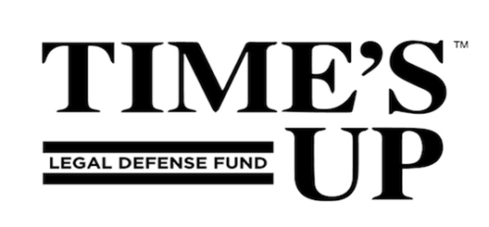
Ethical and Strategic Considerations for Working with
the Media to Support your Clients
Legal Network for 26 September 2024
Gender Equity Webinar 3:00-4:30 pm

Slide 2
Join the Legal Network
for Gender Equity!
nwlc.org/legalnetwork
Notes:
Link to survey: https://forms.office.com/r/snWvkMr2tm

Slide 3
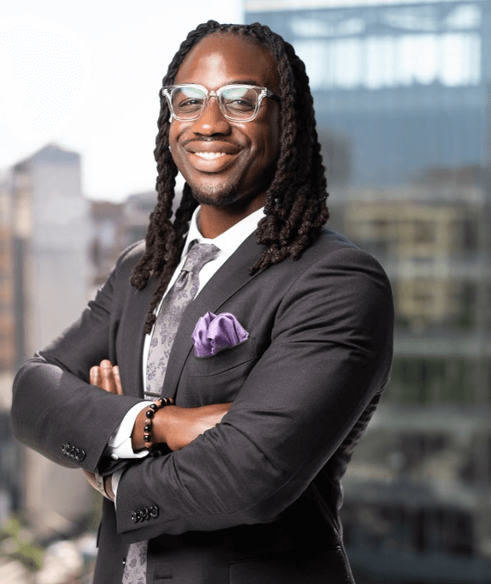
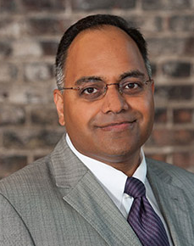
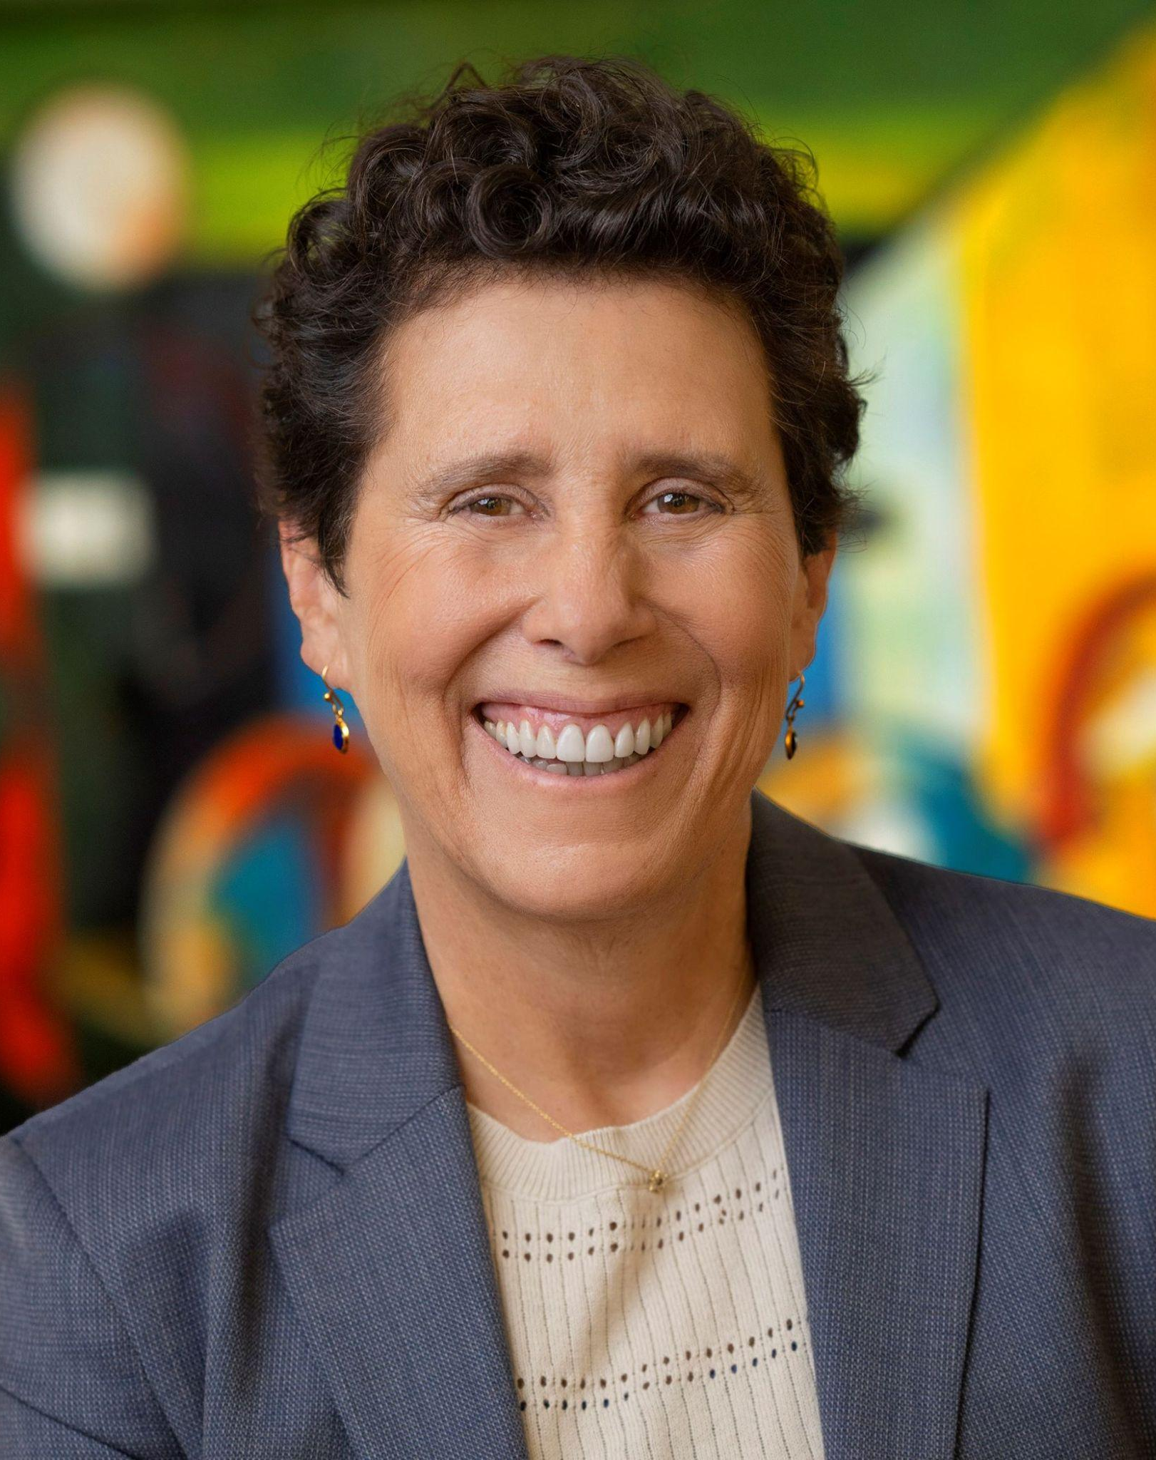
Today’s Panel
Robert Baldwin III (he/him)
Founder and Managing Attorney, Virtue Law Group & formerly Associate Producer, National Public Radio
Subodh Chandra (he/him)
Founder and Managing Partner, The Chandra Law Firm LLC
Debra Katz (she/her)
Founding Partner,
Katz Banks Kumin

Slide 4
Robert Baldwin III (he/ him) is the founder and managing attorney at Virtue Law Group, where he practices plaintiff-side labor and employment with an emphasis on civil rights.
Mr. Baldwin represents government and private sector employees in all aspects of employment law matters before federal agencies in Washington D.C., Maryland, and Virginia, and Maryland federal courts. His experience includes matters of discrimination on the basis of race, sex, sexual orientation, disability; and hostile work environment. He has also litigated breach of contract claims and retaliation.
Speaker bio 1
Prior to founding Virtue Law Group, Mr. Baldwin worked of-counsel with a local employment and business law firm. Before that, he spent time with the American Federation of Government Employees Local 12 representing personnel in the United States Department of Labor and Bureau of Labor and Statistics.
Mr. Baldwin was also formerly an Associate Producer for National Public Radio's All Things Considered and a reporter covering developing legal issues. He was part of the team that won a 2019 National Press Club Award for the breaking news coverage of the Pittsburgh Tree of Life Synagogue shooting.
Mr. Baldwin currently serves as a board member of the Washington Bar Association, where he chairs the Young Lawyer Division. He has been awarded “Young Lawyer of the Year” by both the WBA-YLD and the National Bar Association - Young Lawyer Division. He has also been recognized as a top 40 under 40 by the National Black Lawyers Top 100.

Slide 5
voter-suppression schemes by the Ohio Secretary of State, and the retaliation suit over sexual-harassment allegations that resulted in the resignation of Case Western Reserve University's law-school dean.
Before founding the firm, Mr. Chandra served as director of law for the city of Cleveland, a billion-dollar corporation. He also sometimes served as Cleveland's acting mayor. Previously, as federal prosecutor, Mr. Chandra successfully prosecuted healthcare fraud and corruption—winning a commendation from FBI director Robert Mueller for "demonstrated excellence" as well as from the special agent in charge of the FBI's Cleveland office. Before that, Mr. Chandra served as a litigator in large law firms in both Cleveland and Los Angeles.
Mr. Chandra is a graduate of the Yale Law School, where he was executive editor of the Yale Law & Policy Review. He also graduated with honors and distinction from Stanford University, which awarded him the John Gardner Fellowship to work as a protégé of Ohio Governor Richard F. Celeste.
Mr. Chandra has served as Distinguished Practitioner in Residence at Case Western Reserve University School of Law, teaching appellate practice and legal ethics. He has also served as a legal-ethics and attorneys' fees expert in litigation. Based on the review of his peers, he has been included in Best Lawyers® in America for civil rights and Ohio Super Lawyers®. Under his leadership, Chandra Law has been peer-review included in U.S. News and World Reports' Best Law Firms in America for Civil Rights. And he was named 2022 Lawyer of the Year in Civil Rights by Best Lawyers® in America.
Mr. Chandra's work is featured in the documentaries Free for All! (2008), PAY 2 PLAY: Democracy's High Stakes (2014), and 137 Shots (Netflix 2021).
A former federal prosecutor, law director for the City of Cleveland, and large-firm litigator, Subodh Chandra (he/him) is The Chandra Law Firm LLC's founding and managing partner. His practice focuses on high-profile civil-rights litigation, along with white-collar-criminal defense and internal investigations.
Mr. Chandra is engaged for high-stakes litigation when reputations are on the line. His matters often have a crisis-communications, public-policy dimension. Examples include the police-shooting death of 12-year-old Tamir Rice by Cleveland police—a key moment in the Black Lives Matter movement nationally resulting in a $6,000,000 settlement, the nearly $1,000,000 in settlements for 2016 Republican National Convention protesters, voting-rights litigation against various

Slide 6
Ms. Katz has been cited as a leader in sexual harassment, employment, and whistleblower law by multiple outlets, including The New York Times, The Washington Post, and TIME Magazine. In 2018, she was honored as “Civil Rights Lawyer of the Year” for Washington, D.C. by The Best Lawyers© In America. She has been recognized as a “Top Lawyer” by Washingtonian Magazine since 2004, and in 2023 she was included in the magazine’s “Most Powerful Women in Washington” and “Washington DC’s 500 Most Influential People” lists.
Ms. Katz received her Bachelor of Arts degree, summa cum laude, from Union College, where she was a member of Phi Beta Kappa. She received her J.D. degree, cum laude, from the University of Wisconsin Law School, where she served as a member of the Wisconsin Law Review and as Articles Editor of the Wisconsin Women’s Law Journal. Following law school, Ms. Katz clerked for the Hon. William Bablitch on the Wisconsin Supreme Court and held a Women’s Law and Public Policy Fellowship at Georgetown University Law Center.
Recognized by the Washington Post as “the feared attorney of the #MeToo movement,” Debra Katz (she/her) has been successfully litigating employment discrimination, civil rights, and whistleblower protection cases for nearly 40 years.
Ms. Katz is a founding partner of Katz Banks Kumin LLP, where she concentrates her practice on sexual harassment and whistleblower retaliation, as well as employment discrimination, wrongful discharge, and contractual employment disputes. She has developed extensive litigation experience in federal and local courts and has achieved significant successes in several high-profile cases. Some of her most notable clients include Dr. Christine Blasey Ford, who accused Supreme Court Justice Brett Kavanaugh of sexual assault during his confirmation hearings, and Dr. Rick Bright, a former official at the Department of Health and Human Services who was removed from his position in retaliation for raising concerns about the Trump administration’s response to the COVID-19 pandemic. Ms. Katz also represented multiple women who were sexually assaulted by Harvey Weinstein, as well as Irwin Reiter, a former Weinstein Company executive who provided critical information to the New York Times reporters who broke the scandal.
Speaker bio 1

Slide 7
Rule 3.6: Trial Publicity
Advocate
(a) A lawyer who is participating or has participated in the investigation or litigation of a matter shall not make an extrajudicial statement that the lawyer knows or reasonably should know will be disseminated by means of public communication and will have a substantial likelihood of materially prejudicing an adjudicative proceeding in the matter.
(b) Notwithstanding paragraph (a), a lawyer may state:
(1) the claim, offense or defense involved and, except when prohibited by law, the identity of the persons involved;
(2) information contained in a public record;
(3) that an investigation of a matter is in progress;
(4) the scheduling or result of any step in litigation;
(5) a request for assistance in obtaining evidence and information necessary thereto;
(6) a warning of danger concerning the behavior of a person involved, when there is reason to believe that there exists the likelihood of substantial harm to an individual or to the public interest; and
(7) in a criminal case, in addition to subparagraphs (1) through (6):
(i) the identity, residence, occupation and family status of the accused;
(ii) if the accused has not been apprehended, information necessary to aid in apprehension of that person;
(iii) the fact, time and place of arrest; and
(iv) the identity of investigating and arresting officers or agencies and the length of the investigation.
(c) Notwithstanding paragraph (a), a lawyer may make a statement that a reasonable lawyer would believe is required to protect a client from the substantial undue prejudicial effect of recent publicity not initiated by the lawyer or the lawyer's client. A statement made pursuant to this paragraph shall be limited to such information as is necessary to mitigate the recent adverse publicity.
(d) No lawyer associated in a firm or government agency with a lawyer subject to paragraph (a) shall make a statement prohibited by paragraph (a).
Speaker bio 1

Slide 8
Questions?
Robert Baldwin III (he/him)
Founder and Managing Attorney, Virtue Law Group & formerly Associate Producer, National Public Radio
Subodh Chandra (he/him)
Founder and Managing Partner, The Chandra Law Firm LLC
Debra Katz (she/her)
Founding Partner,
Katz Banks Kumin

Slide 9
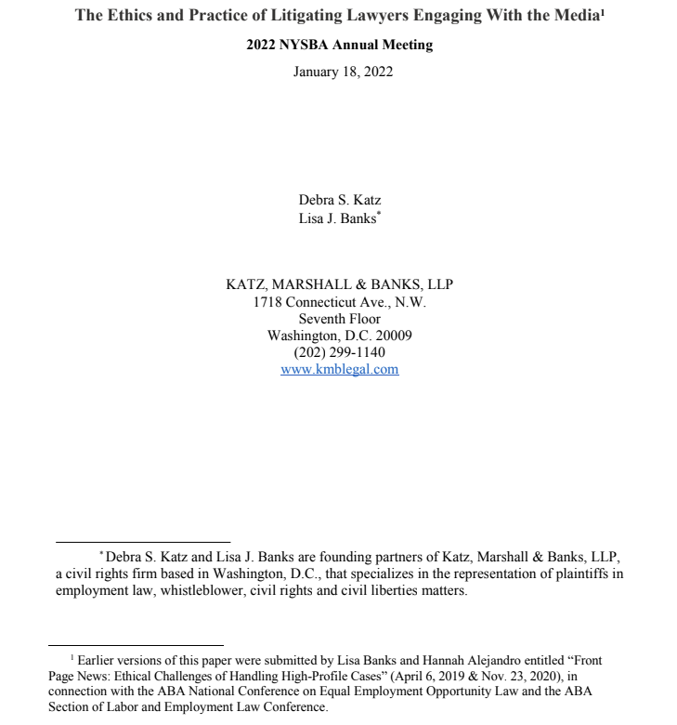
Survivors Speaking Out:
A Toolkit About Defamation Lawsuits and Other Retaliation
By and For People Speaking Out About Sex-Based Harassment
https://nwlc.org/resource/survivors-speaking-out-toolkit-defamation-retaliation/

Slide 10
Take our survey!
Join the Legal Network for Gender Equity!
Follow us on social media!
nwlc.org/legalnetwork
@nwlc
facebook.com/nwlc
@nationalwomenslawcenter
Notes:
Link to survey: https://forms.office.com/r/snWvkMr2tm

