Slide 1

Representing Military Survivors of Sex Harassment and Sexual Violence
Adelaide Kahn, Director of Programs & Policy, Protect Our Defenders
Col. Don Christensen, U.S. Air Force (Ret.); President, Protect Our Defenders
Lt. Col. Breck Perry, U.S. Marine Corps
Adrian Perry, Co-Founder, Survivors United

Slide 2
Military Justice Authority
U.S. Constitution
Appellate Courts
Uniform Code of Military Justice (UCMJ)
  Articles
  Punitive Articles
Military Rules of Evidence (MREs)
  Based on FREs
Rules for Court Martial (Procedural Rules)

Slide 3

Jurisdictional issues
The military can exercise jurisdiction over a servicemember no matter where they are located
Joint jurisdiction
  Most crimes committed by servicemembers in the U. S. and abroad fall under the jurisdiction of at least military + local civilian authorities
    The survivor may report to either the civilian or military authorities, and may express preference to utilize either system, but this is rarely acknowledged.
    Either military or civilians will decide to take case.
    Double jeopardy does not typically apply; if one side fails to produce a conviction, the other side can proceed.

Slide 4
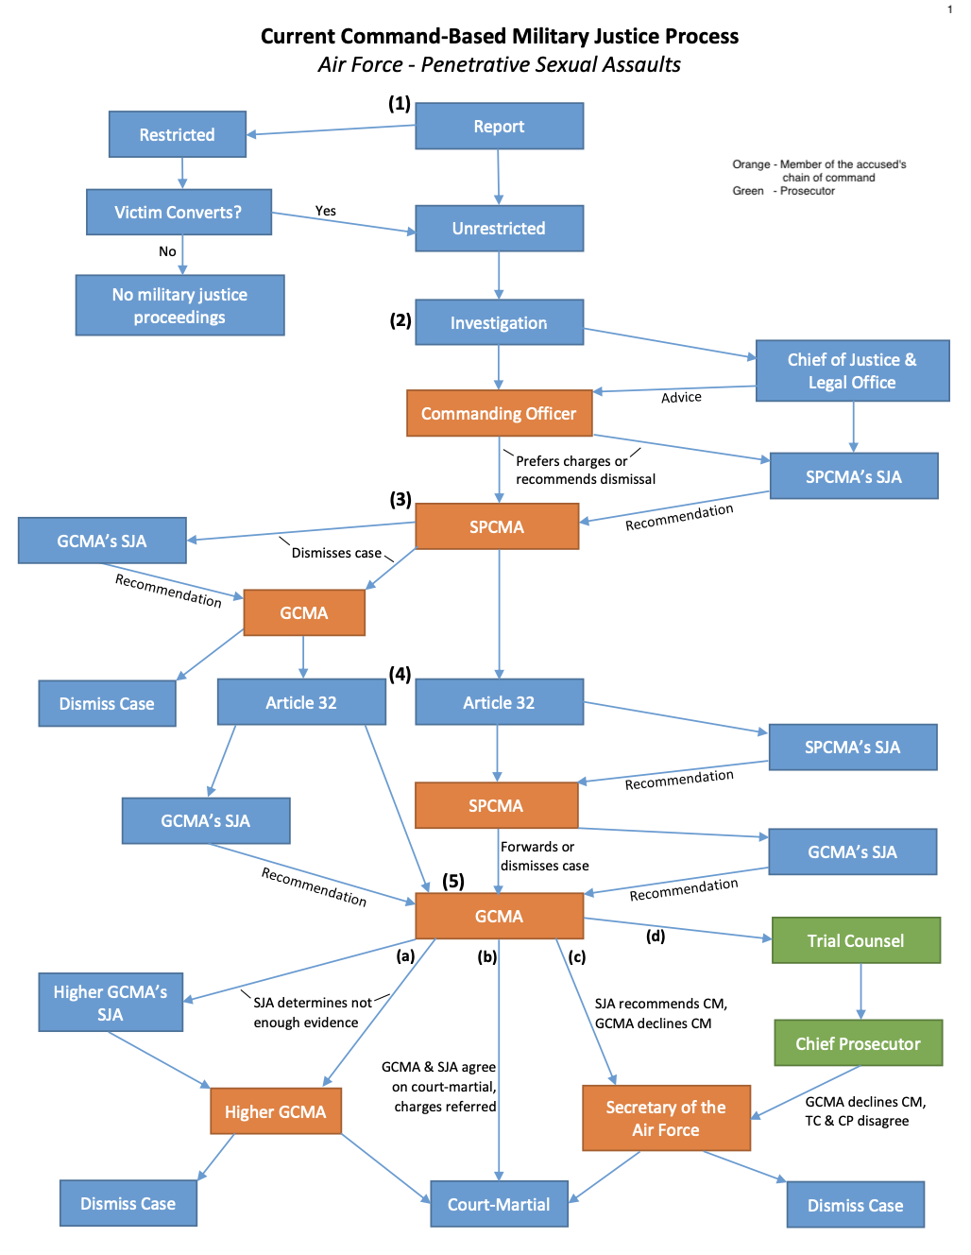
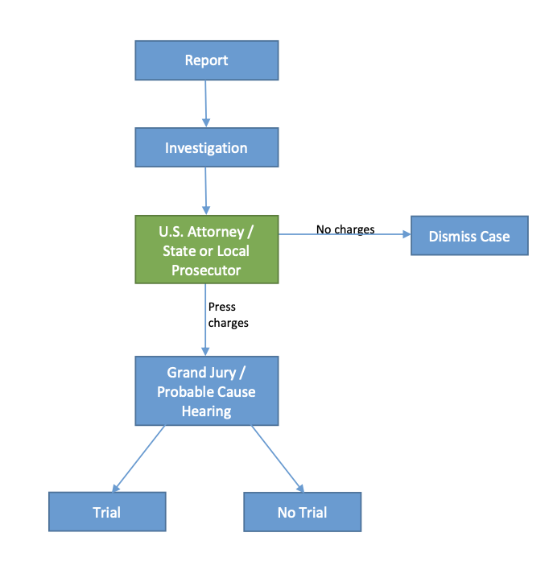
Civilian Justice Process
Military Justice Process
Service Secretary

Slide 5
How does DOD handle sexual harassment?
Not very well
Estimated 50,000 servicewomen are sexually harassed every year
  Only about 1,000 make a report
EO formal/informal
Command-directed Investigation (CDI)
Almost never prosecuted
Article 92 Dereliction of Duty
Article 93 Maltreatment
Article 133 Conduct Unbecoming

Slide 6
Conviction rates for sexual assault in the military: 2019 data from the SAPRO Report
5,699 Unrestricted reports
363 Cases were prosecuted
138 Convictions for rape or sexual assault
2,126 Restricted reports

Slide 7
How is sexual assault reported?
Restricted Report | Unrestricted Report
Report made to a Victim Advocate (VA), Sexual Assault Response Coordinator (SARC), SVC/VLC, chaplain, medical professional, roommate, friend, or family member | Any report made to a commander, chain of command, military law enforcement, or civilian law enforcement is Unrestricted
Does not trigger an investigation | Can also choose Unrestricted when reporting to VA, SARC, chaplain, or medical professional
Survivor has access to medical care | Triggers an investigation
Victim can choose to make report Unrestricted | Survivor has same access to medical and mental healthcare, is assigned an SVC/VLC, and can request that victims’ rights be invoked
Active Duty/dependent survivor is entitled to SVC/VLC | Unrestricted report cannot be made Restricted

Slide 8
Justice options for sexual violence
Article 15
Summary Court
Special Court
Article 32 Hearing
General Court
Administrative actions
Actions in lieu of Court Martial

Slide 9

The Commander
Military Justice is a command tool
Commander of the accused’s authority
  Pretrial restrictions on liberty including protection orders and confinement
Order investigations
Stop a case from going forward (with limits)
Prefer charges
Forward charges

Slide 10
The Convening Authority
Special command position
Vast authority and discretion
Can send a case to trial or kill it
Selects the court members (jury)
Approves plea bargains (PTAs)
Dismisses or adds charges
Authorizes appeals

Slide 11
3 types of courts-martial
Summary
  Not for officers, usually junior enlisted
  30 days of confinement
  No judge or jury
Special (Misdemeanor)
  Usually not used for officers
  Judge and jury of 4 (Judge-Alone Special)
  Maximum of 1-year, Bad Conduct Discharge
General (Felony)
  Article 32
  Judge and jury of 8
  Maximum depends on offense; up to death and/or life in prison
No Standing Courts

Slide 12

Players
Trial Counsel
  Always a Judge Advocate General (JAG)
  Usually inexperienced
Defense Counsel
  Can be a JAG or a civilian or both
Staff Judge Advocate (SJA)
  Advisor to the convening authority – quasi judicial
  Not your client’s friend

Slide 14

Players
Special Victims Counsel (SVC)/Victims Legal Counsel (VLC)
  JAG with confidentiality
  Attorney/client relationship with victim
  Advocate
  Very likely inexperienced
  Role in court is not settled
  Limited to “ID” cardholders and DoD employees

Slide 15
Overview of the process for allegations of sex offenders
Reporting by the victim (Restricted of Unrestricted)
Investigation – required for allegations of sex offenses
  Office of Special Investigations (OSI)/Criminal Investigation Division (CID)/Naval Criminal Investigative Service (NCIS)
    Usually inexperienced
  Local or foreign jurisdictions as well; victim has a right to request civilians prosecute case – Rules for Court Martial (RCM) 306(e)
Article 32 Hearing
Courts-martial
Appellate Courts

Slide 16
Article 32 hearing
Probable cause hearing required before a general court-martial
Presided over by a JAG (usually)
  Likely not that experienced in sexual assault cases
Victim has right not to testify
Prior sworn statements can be admitted into evidence
Recommendation of hearing officer is not binding
Controlled by RCM 405
Military Rule of Evidence (MRE) 412 applies

Slide 17
What are a military victim’s basic rights in this process?
Reasonable protection from the accused
Proceedings free from unreasonable delay
Restitution as provided by law
Not to be excluded from proceedings
The right to be reasonably heard
The reasonable right to confer with the government
Reasonable, accurate, and timely notice
The right to be treated with fairness and with respect for the dignity and privacy of the victim

Slide 18

Right to be heard
LRM v. Kastenberg, 72 M.J. 364 (2013)
  Kastenberg made it clear that the right to be heard meant the right to be heard through counsel in relation to Article 6b rights
Right to be heard through counsel includes:
  Pretrial confinement hearings
  Sentencing hearings – limits on allocution rights
  Clemency/parole board hearings
  Enforcement of 6b rights

Slide 19

Right to notice
Right to reasonable, accurate, and timely notice:
  Pretrial confinement hearing
  Article 32
  Court-martial
  A public clemency and parole board hearing
  The release or escape of the accused
Military must ensure SVC is “provided prompt and adequate notice of the scheduling of any hearing, trial, or other proceeding…in order to permit such counsel the opportunity to prepare for such proceeding.”

Slide 20

Right to confer
The reasonable right to confer with the counsel representing the Government at:
  Pretrial confinement hearing
  Article 32
  A court-martial
  Clemency/parole board proceeding
RCM 306(e)
  Civilian v. military preference
RCM 705(e)(3)(B)
  Plea agreements

Slide 21
Rape shield: MRE 412
Prohibited Uses
  The following evidence is not admissible in any proceeding involving an alleged sexual offense except as provided in subdivisions (b) and (c):
    1) Evidence offered to prove that a victim engaged in other sexual behavior; or
    2) Evidence offered to prove a victim’s sexual predisposition.

Slide 22
MRE 412 Exceptions
  In a proceeding, the following evidence is admissible, if otherwise inadmissible under these rules:
    (A) Evidence of specific instances of sexual behavior by the alleged victim offered to prove that a person other than the accused was the source of semen, injury, or other physical evidence;
    (B) Evidence of specific instances of sexual behavior by the alleged victim with respect to the person accused of the sexual misconduct offered by the accused to prove consent or by the prosecution; and
    (C) Evidence the exclusion of which would violate the constitutional rights of the accused.
      Does not apply at Article 32.

Slide 23

MRE 412 Trial Test
If the military judge determines on the basis of the hearing that the evidence is relevant for a purpose under subsection (b) and that the probative value of such evidence outweighs the danger of unfair prejudice to the alleged victim's privacy, such evidence shall be admissible under this rule to the extent an order made by the military judge specifies evidence that may be offered and areas with respect to which the alleged victim may be examined or cross-examined.
  Such evidence is still subject to challenge under MRE 403.

Slide 24

Psychotherapy Records: MRE 513
General rule of privilege
  A patient has a privilege to refuse to disclose and to prevent any other person from disclosing a confidential communication made between the patient and a psychotherapist or an assistant to the psychotherapist, in a case arising under the UCMJ, if such communication was made for the purpose of facilitating diagnosis or treatment of the patient's mental or emotional condition.

Slide 25
MRE 513 Burden
A party seeking production or admission of records or communications protected by the privilege must:
  Show a specific factual basis demonstrating a reasonable likelihood that the records or communications would yield evidence admissible under an exception to the privilege;
  Demonstrate by a preponderance of the evidence that the requested information meets one of the enumerated exceptions to the privilege;
  Show that the information sought is not merely cumulative of other information available; and
  Show that the party made reasonable efforts to obtain the same or substantially similar information through non-privileged sources.

Slide 26


DISCOVERY ISSUES AND CHALLENGES
What can the victim see?
What can the accused see?

Slide 27

Appellate courts
Service Courts
  Military judges
Court of Appeals for the Armed Forces (CAAF)
  Civilian judges
Article III Courts?
Appellate rights?
Government appellate offices
SVC/VLC appellate offices

Slide 28
Appellate “Rights”
The victim may petition the Court of Criminal Appeals for a writ of mandamus.
Applies with respect to the protections afforded by Article 6(b) (victim rights).
Article 32
MREs 412, 513, 615
To the extent practical, shall have priority over other proceedings before the court.

Slide 29
Recent reforms
Article 32
Depositions
Mental health records
Good Military Character
Victim's appellate rights
SVC/VLC
Right to consult with decision authority
Eliminate no punishment option
Eliminates authority to overturn verdicts
Criminalize "revenge porn"
Criminalize domestic violence
Sentencing guidelines

Slide 30
Victim Advocacy: The Perry’s
Personal experience
Importance of having civilian Victim Legal Counsel
Common themes

Slide 31
Questions?

